Slide 1

Corporate Social Responsibility
(CSR)
Session 3.1
Notes:
Alsom: What is CSR: https://www.youtube.com/watch?v=59KilQ6YSZc
HP: https://www.youtube.com/watch?v=z9x93s-oudI&list=PLFPG9sbIS1YVPZf_GX7s0K9XdKi6S_nCr&index=1
FSG (doing well by doing good): https://www.youtube.com/watch?v=1vK3cxnP6I4&list=PLFPG9sbIS1YVPZf_GX7s0K9XdKi6S_nCr
Safeway: https://www.youtube.com/watch?v=WPhWriqKjLU&list=PLFPG9sbIS1YVPZf_GX7s0K9XdKi6S_nCr
Jack Black: http://m.youtube.com/watch?v=gbx8jpEW_jo
Coke and India: https://www.youtube.com/watch?v=ts_4vOUDImE
Coke draining water supplies: https://www.youtube.com/watch?v=OnowxqVqmF0 http://www.waronwant.org/media/coca-cola-drinking-world-dry

Slide 2
Learning Outcomes
Know
Understand what Corporate Social Responsibility is, it’s purpose, and ways to evaluate its effectiveness.
Feel
A desire to be anxiously engaged in good causes throughout your professional and personal lives
Do
Meet with you team and create a timeline to make steady progress on your final team project.

Slide 3
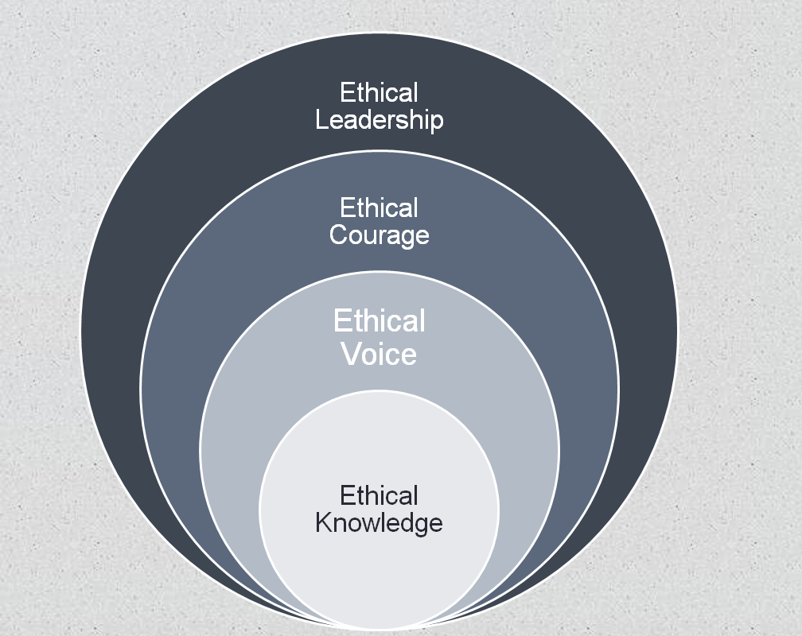
Macro
Symbolic/Executive
Stakeholder Theory
CSR
Power and Politics
Meso
Interpersonal
Obedience
Roles
Value Propositions
Social Pressure
Micro
Intrapersonal
Philosophy
Psychology
Neurology

Slide 4
CSR
“Verily I say, men should be anxiously engaged in a good cause, and do many things of their own free will, and bring to pass much righteousness.”
        (D&C 58:27)

Slide 5
CSR: What is it?
A concept whereby companies decide voluntarily to contribute to a better society and a cleaner environment.
--European Commission
CSR is about how companies manage their business processes to produce an overall positive impact on society.
--Mallen Baker (2004)
Operating a business in a manner that meets or exceeds the ethical, legal, commercial and public expectations that society has of business.
--Business for Social Responsibility
Notes:
Here show

Slide 6

CSR: Purpose
Internal Focus
Values-driven
  Do good, fulfill CEO/Founder Codes of Ethics
    Sincere “tone at the top.”
Enhance employee identification.
  Weyerhaeuser: “The tree planting company.”
  HP: “The betterment of our society is not a job to be left to a few. It’s a responsibility to be shared by all.”
  --David Packard

Slide 7

CSR: Purpose
External Focus
  Stakeholder theory
  Corporate Rebranding
    What are common stereotypes of business executives?
      Heartless/Selfish/Elitist
      Distrust
        Less than 1 in 5 people trust business leaders to tell the truth (2013 study).

Slide 8

CSR: Effectiveness
CSR is in vogue, but are there any controls or systems to prove CSR efforts are beneficial?
“Do Good. Better”—Ballard Center
Can trying to do good actually be harmful?
    Goats in Ghana
    Shoes from Tom’s

Slide 9
Customized CSR
  What are the potential CSR issues (potential liabilities, unique capacity to benefit society)
  for these industries/firms?
  Vivint?
  Professional Sports Teams?
  Banks?
  Coal mines?
  Aluminum Manufacturers?
  Nu Skin?

Slide 10
Team Activity
Pull up the team project description on Learning Suite. Read the CSR Strategy Report section.
List companies you would like to examine for your CSR analysis.
Before doing any research, begin to brainstorm the CSR potential (liabilities, unique capacity to benefit community) of the companies you selected.
Decide on a company and its comparison firms, and begin to plan a timeline for the project.

